Slide 1
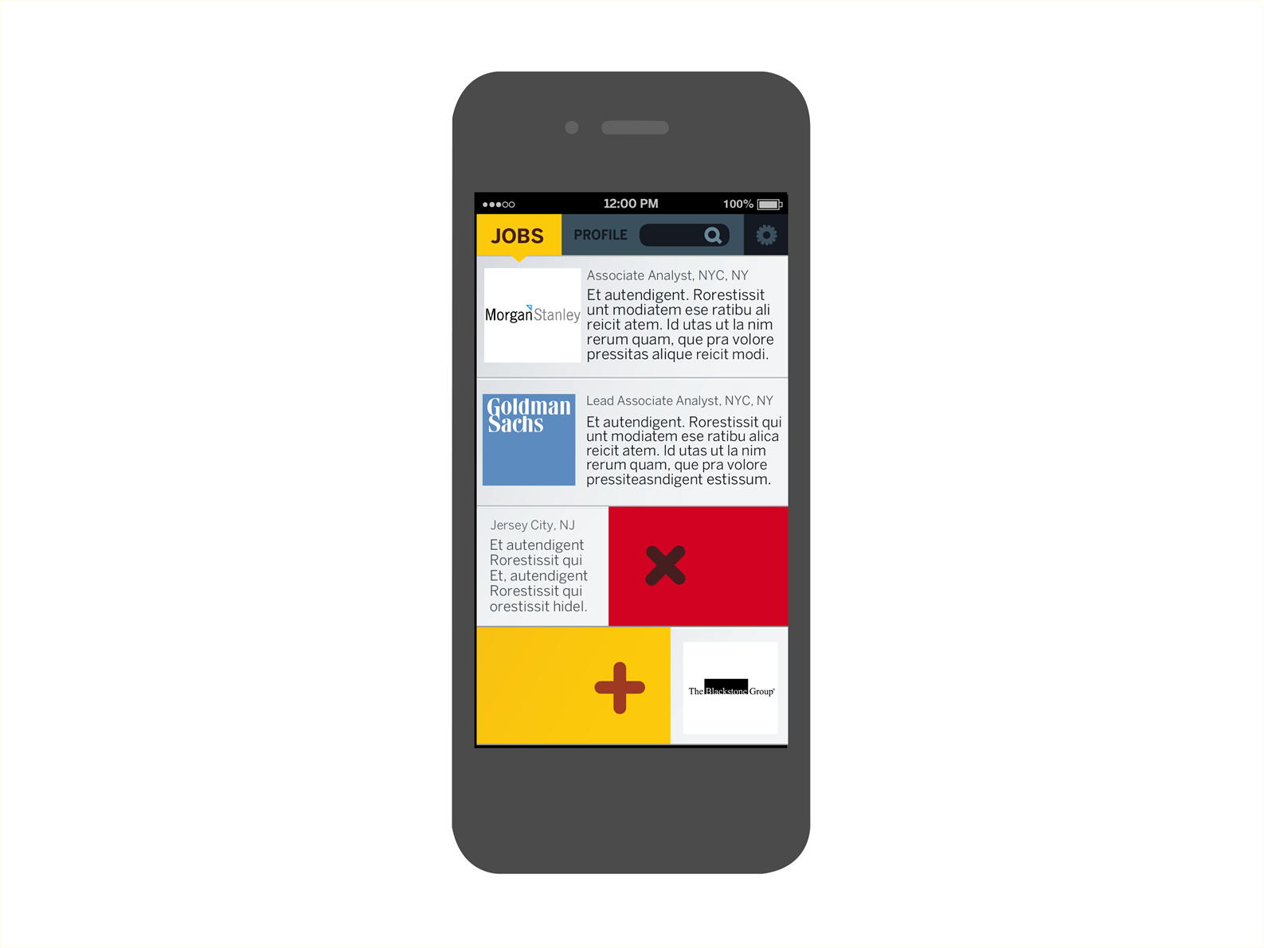

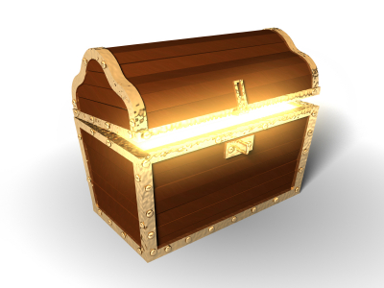
Bee’s Chest
Click on App

Slide 2
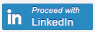
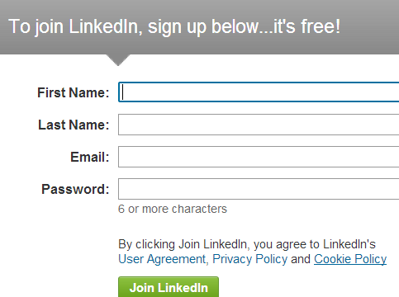
Login through LinkedIn
Register on LinkedIn
-track LI sign up to see how many people we converted
How to address same person with multiple profiles to consolidate (if we enable FB and Twitter login)

Slide 3
Send user to LinkedIn to register
Authentication protocol
Oauth2 – talks to LI, login, and then login through own service
Make account on own service and connected to linkedin, and exists within our own service
For best experience use LI account, but can login through FB, Twitter too
Can make LI account through our APP.

Slide 4







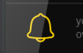
CONTACT NOTES
Randomly generated profile from LI based on recent phone contact– i.e. I talked to my brother yesterday on the phone, so LI generates his profile to verify his stats. Random generation starts with most recent contacts. If I’m okay with profile I can save it.
Auto save after edit.
To edit box, just push on field and start typing.
Can edit fields over time too – updates on back-end
Scroll bar for jobs beyond 1. Scroll bar for universities beyond 1.
verify or enter categories – Categories are sourced from LinkedIn profile if they exist – pulling from jobs field for industry; skills from skills or talent part; personality needs to be manually entered
Scroll for more “skills” beyond 3.
First category – industry/job function
Second – skills
Third – Personality/Other
Have little “x” or “-” next to field to delete
Smart Lookup is just a field that allows for data entry
Contacts can also have a notification for someone who you recently added to the phonebook
RATE Game NOTES
Game activates when two profiles need a tie break.
Two tags have been identified as equal from the skills or personality fields.
For example, 2 profiles pulled from LinkedIn indicate two people tagged as “marketing”, “teamplayer”, “smart”, etc. Then it asks who’s better?
The word generated is by a tie.
The profiles can be random if there are multiple ties.
User pushes profile to indicate better
After saved, it goes to the next profile.
The system works like ELO – winners advance to play winners and losers play losers. Then when there are tied records, there is game again. This separation feeds the search engine to organize the list
The game is generated on the home screen with a notification that shows up as a bell on the “rate”
Settings
Contacts
Search
Rate
Search…
Bee’s Chest
Search
Contacts
ABC
You
NET
Name
Cell
Work Phone
Email (Gmail default)
Name
Company
Position
Last University
Last Degree
View Resume
Company Position
Previous company Position
….
Last University Degree
Undergrad University Degree
…. Other univ.
Name
Company
Position
Last University
Last Degree
Who’s better…
Teamplayer
Name
Company
Position
Last University
Last Degree
Industry
Skill
Personality
German X
Epidemiology X
Clever X
Genetics X
Russian X
Fun X
Researcher X
SPSS X
Funny X
Rate
Contacts
Profile
Smart Lookup
Lookup
Lookup
Left well of contacts pops when you swipe phone to right
Right well of contacts pops when you swipe phone to left

Slide 5
Settings
For location -
Can list home address, Zipcode, or maybe GPS for city
Password if not LinkedIn:
Activation of service – local or wifi connected? Might give option to not upload stats to server
Vibrate when notification?
Status: based on profiles edited
0-25 profiles – begin bee
26-50- honeybee
50-100- bumble bee
100-200 – carpenter bee
201 –500- wasp
501-700- hornet
701-999 yellow jacket
1000-1999 – killer bee
2000+ - network bee
Give some info about what it means to have that many connections – what %,
piechart of network based on high level industries:
Your network is 20% tech, 40% business…
Profile is pretty much the same as Contacts.
What you fill out for your own profile should be the first attributes that others see and can evaluate before pulling from LinkedIn. LinkedIn is the default for people who haven’t subscribed yet.
Same scroll feature to access more info.
Resume button lets user save PDF or Word Doc of Resume from LinkedIn or wherever stores.
Settings
Search…
ABC
You
Profile
Resume
NET
Name
Company
Position
Last University
Last Degree
Location:
Name
Cell
Work Phone
Email
Password:
Deactivate:
Vibrate for notification:
Status:
Name
Company
Position
Last University
Last Degree
Company Position
Previous company Position
….
Last University Degree
Undergrad University Degree
…. Other univ.
Name
Company
Position
Last University
Last Degree
Industry
Skill
Personality
Tech X
Marketing X
Fun X
Market Res X
Spanish X
Leader X
Restaurant X
Chess X
Contacts
Profile
Bee’s Chest
Friendly X
Smart Lookup
Lookup
Lookup

Slide 6

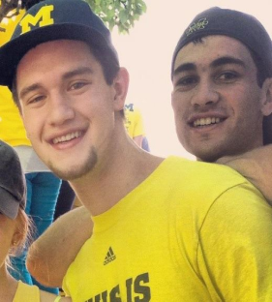



If you hit “YOU” search mode, the candidates will be in order of who you tagged and rated. If no rating, then the order will be generated by most tags done by you followed by most recent phone call.
If no tags, then it’ll default to LinkedIn tags that you haven’t confirmed. And then rank by most tags followed by most recent phone call.
LinkedIn users that you are connected with will be colored.
If you hit “NET” search, this is how your network in common views your phonebook contacts. It excludes your input. So, it’s a rank based on your networks tagging, followed by a weight based on their rating.
These users would have to be LinkedIn or Bee’s Chest users for the software to know that the individual is in the same person between users.
The default of the phone app is to load all the names by alphabet as is now with the phone.
If you hit ABC without search, it’ll load the list alphabetically based on who you are connected to on LinkedIn.
If you type a search – it’ll load a list alphabetically phonebook + LinkedIn, but it will color the LinkedIn users that you are connected with.
Cepeda
ABC
You
Developer
ABC
You
Developer
ABC
You
NET
NET
NET
Camilo Cepeda
Company
Position
Last University
Last Degree
Dom Parise
Company
Position
Last University
Last Degree
Chris O’Neil
Company
Position
Last University
Last Degree
Diego Cepeda
Company
Position
Last University
Last Degree
Chris O’Neil
Company
Position
Last University
Last Degree
Billy Irwin
Company
Position
Last University
Last Degree
Javier Cepeda
Company
Position
Last University
Last Degree
Tom Erdmann
Company
Position
Last University
Last Degree
Tom Erdmann
Company
Position
Last University
Last Degree
Contacts
Profile
Bee’s Chest
Contacts
Profile
Bee’s Chest
Contacts
Profile
Bee’s Chest

Slide 7
CONSIDERATIONS
Tag all features “buttons” to see where you user interacts – usability testing
Login through FB and Twitter?! – pull job title and job. See if hobbies or interests can be pulled into personality?!
Match phone identity with LinkedIn identity by email or phone number. For duplicate names, function that recommends joining phone profiles.
If not LinkedIn user, could add functionality to scrape resume or doc and drop into our own fields like how LinkedIn does it.
Web service - basic registration online and link to download app. What’s the plan?
Relational database?
Security? – what needs to be done to prevent hacking into our data?
Invitation for users who might want to share contact
Fields from LI, fields from phone, background architecture
Generation of game when match is made
Server – populates newest data set – when you rank or tag attribute – can store and then load when connected…
Full contact list on device
When first login may load photos … store on phone… save on dowloading everytime and have work when offline
User connects to server – server to network back to user.
Search
ABC
You
NET
Name
Company
Position
Last University
Last Degree
Name
Company
Position
Last University
Last Degree
Name
Company
Position
Last University
Last Degree
Contacts
Profile
Bee’s Chest

Slide 8



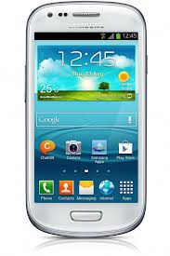

Architecture
1. Bee’s Chest is loaded on the phone.
2. Registration requests LI for permission.
3.Then profile exists on phone.
4. If no registration, then Bee’sChest offers auto LI registration
5. Bee’sChest can have its own profile if user doesn’t want LI
6. Known phone data is on the phone and integrated with Bee’s Chest.
7. Bee’s Chest pulls fields from LI.
8. Bee’s Chest matches phone data with LI dataset
Bee’s Chest loads different screens from local phone data. For the game and tagging, this opens communication with the server to feed in profiles and tags. When user stops game, data stores locally and then transfers changes to server.
9. Phone loads app synchronized
10. Phone loads newest data to cloud.
11. Cloud sends newest updates in network to phone
12. Web Service and Server update
13. App sits in app store
12. Web = Mobile APP
10. When connected, send data to cloud.
11. When connected, send data to phone
Phone data
5. New user stored on web service
www.beeschest.com
13. Download app
9. Store Bee’s Chest locally
1. User on
Bee’s Chest
2&4. LI User Registration
Or auto register
6. Store phone data in Bee’s Chest
7. Store LI data in Bee’s Chest
8. Data matched
PHONE |  |  |  | USER | LINKEDIN
Phone Number | Work Phone | Email | Timestamp Call | Overlay (Tags) | Company 1 | Job Function 1 | University 1 | Degree 1 | Start Year for each job function | End Year for each job function | 1st degree Network connections | Activities and Societies | Courses | Skills and Expertise | Languages | Email (to match against phone) | Groups
 |  |  |  |  | Company 2 | Job Function 2 | University 2 | Degree 2
 |  |  |  |  | Company 3 | Job Function 3
 |  |  |  |  | … | …

Slide 9
